Slide 1
Anomaly Detection Datasets

Slide 2



What are we going to learn?
Collect and Preprocess Data
Design
and Train
Model
Evaluate, Optimize, Convert, Deploy
Make
Inferences
Micro
Challenges with an Anomaly Detection Application
Anomaly Detection ML Pipeline
Training, Testing
in Colab
Notes:
Challenges = Bandwidth, Battery, Latency, Accuracy, Datasets
The AD ML Pipeline = Real World case studies of how to anomaly detection implemented in industry
Hands-on training and of anomaly detection models in Colab!

Slide 3


Collect
Data
Preprocess
Data
Design a
Model
Train a
Model
Evaluate
Optimize
Convert
Model
Deploy
Model
Make
Inferences
Micro

Slide 4
Collect
Data
Preprocess
Data
Design a
Model
Train a
Model
Evaluate
Optimize
Convert
Model
Deploy
Model
Make
Inferences
Micro

Slide 5
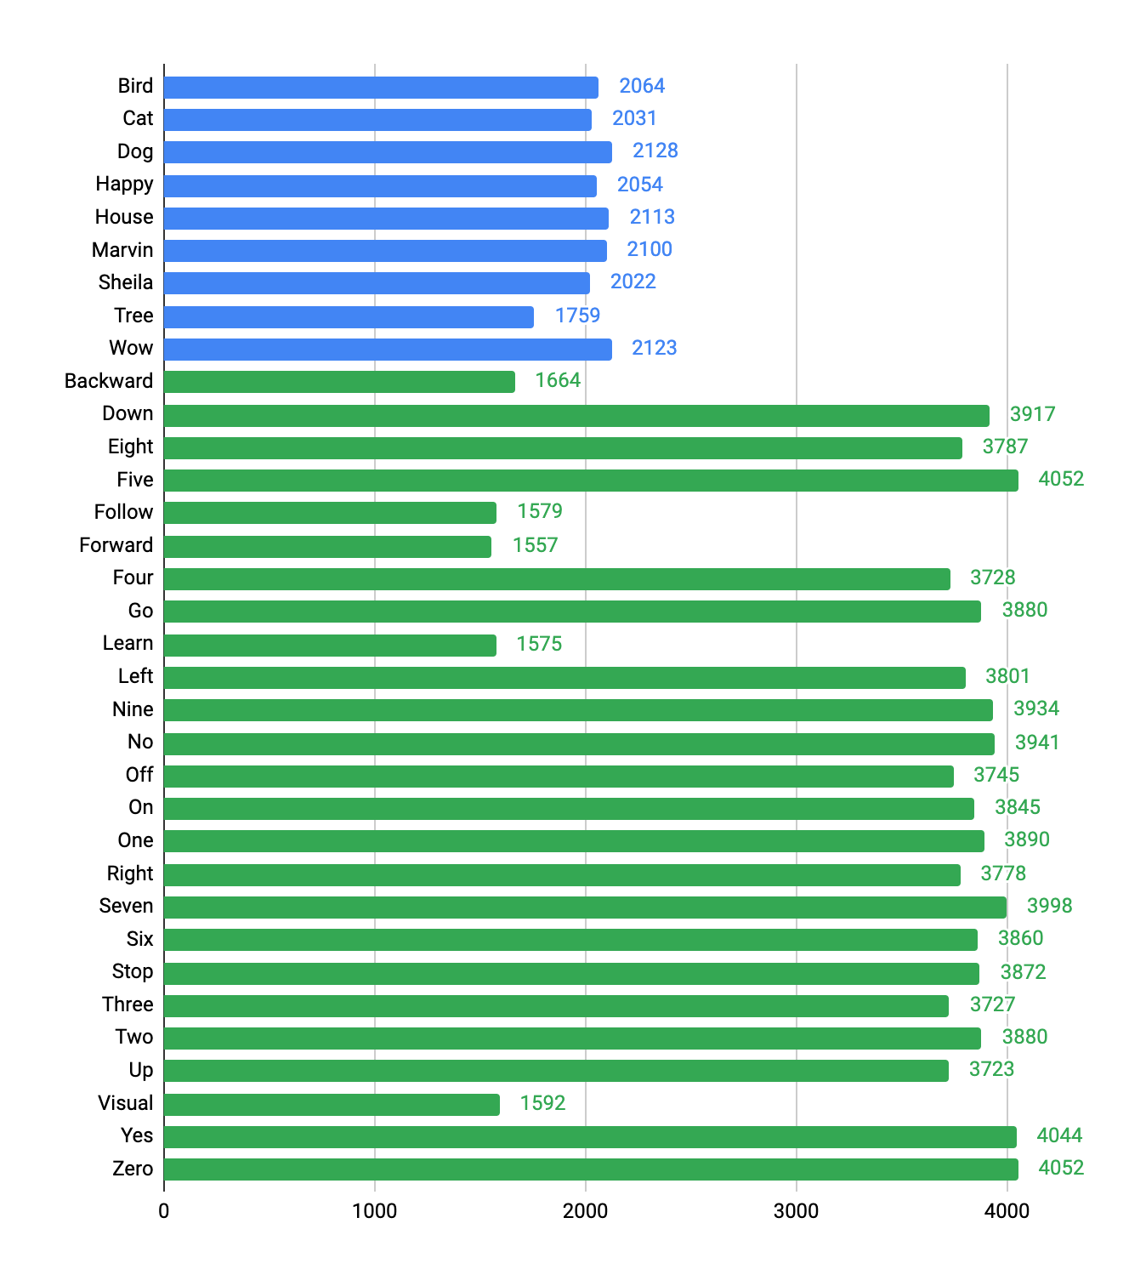
The Speech Commands Dataset
25 “IoT keywords” + 10 “unknown words”
The set of words is known in advance
keyword
utterances
Notes:
In the previous we’ve covered, the application designer knows what want data to detect. For keyword spotting we know that we want to activate the system when a specific word or set of words is detected.

Slide 6
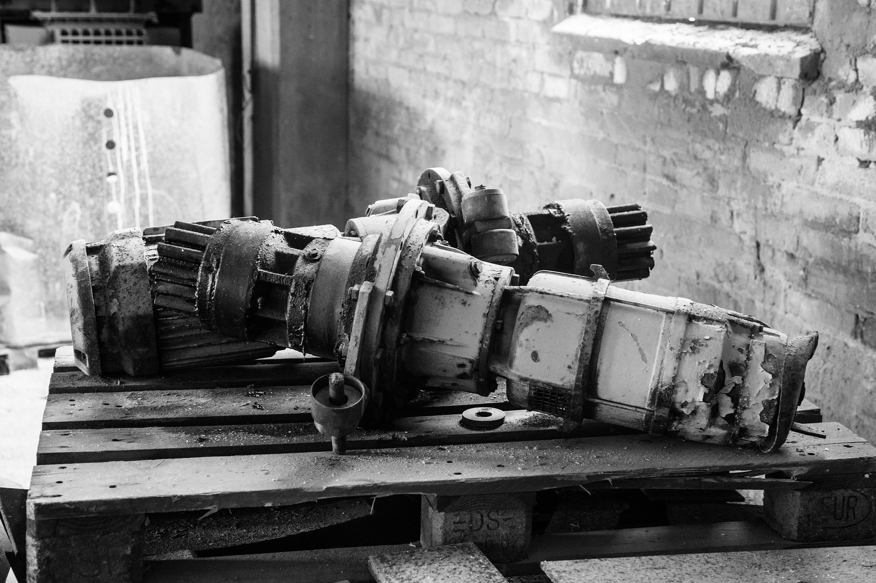
Creating an Anomaly Detection Dataset
Machine Failure
Notes:
Collecting data on anomalies can be challenging as it involves capturing an inherently rare event. Additionally, it can cost a significant amount of money as it often involves reaching a critical failure state.
https://pixabay.com/ru/photos/%D1%81%D0%BB%D0%BE%D0%BC%D0%B0%D0%BD%D0%BD%D1%8B%D0%B5-%D0%BF%D1%80%D0%BE%D0%BC%D1%8B%D1%88%D0%BB%D0%B5%D0%BD%D0%BD%D1%8B%D0%B5-%D1%82%D0%BE%D0%B2%D0%B0%D1%80%D1%8B-%D1%80%D0%B0%D1%81%D0%BF%D0%B0%D0%B4-1513205/

Slide 7
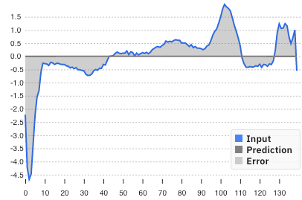
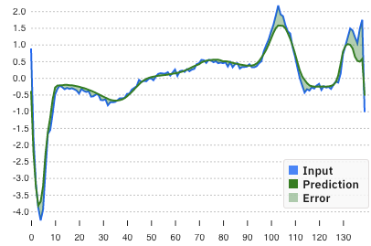
How are Anomaly Detection Datasets different?
Normal Data
Notes:
Normal data is an closed set, meaning we know what normal operation looks like and can easily capture that data.
MIT liscenece shoudl be good https://github.com/victordibia/anomagram/blob/master/LICENSE
Graph Screenshots from https://anomagram.fastforwardlabs.com/#/

Slide 8
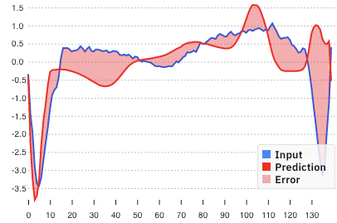
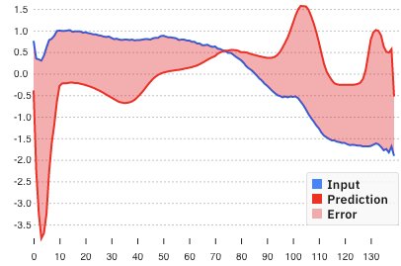
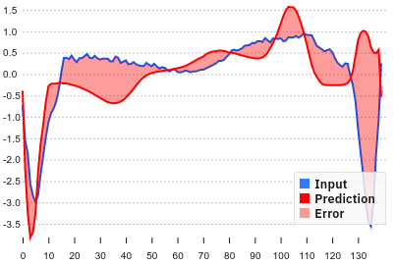
How are Anomaly Detection Datasets different?
Normal Data
Abnormal Data
...
Notes:
Abnormal data is an open set since a system can fail in any number of unpredictable ways. (Unknown unknowns)
Therefore we need a way to train a model to detect something that we can’t capture complete in our dataset.

Slide 9
Unbalanced Data
Notes:
Adds an additional challenge to training. There is far more ‘normal’ data than ‘abnormal’ but it’s critical to catch the anomaly
Always guessing no anomaly would lead to high perceived accuracy

Slide 10
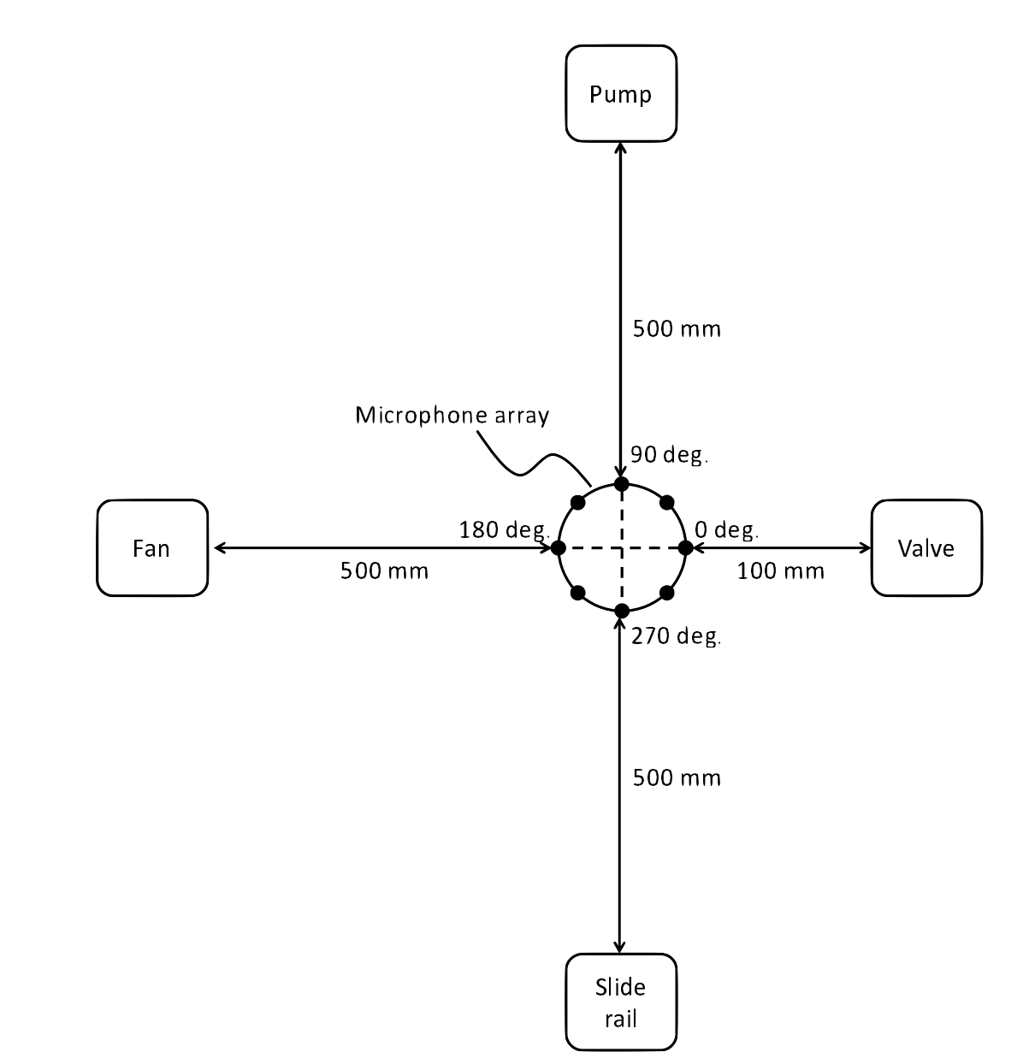
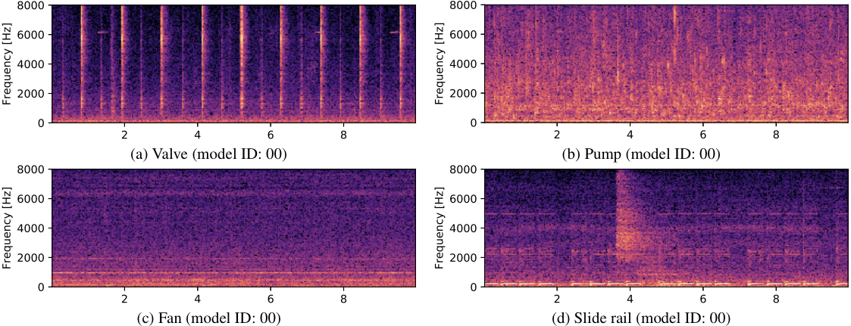
Example: MIMII Dataset
Sound Dataset for Malfunctioning Industrial Machine Investigation (MIMII)
Anomaly Detection
Purohit, Harsh, et al. "MIMII dataset: Sound dataset for malfunctioning industrial machine investigation and inspection." (2019).
Notes:
new dataset of industrial machine sounds that we call a sound dataset for malfunctioning industrial machine investigation and inspection (MIMII dataset).
of our knowledge, there is no public dataset that contains different types of machine sounds in real factory environments.
Normal sounds were recorded for different types of industrial machines (i.e., valves, pumps, fans, and slide rails),
and to resemble a real-life scenario, various anomalous sounds were recorded (e.g., contamination, leakage, rotating unbalance, and rail damage).
The purpose of releasing the MIMII dataset is to assist the machine-learning and signalprocessing community with their development of automated facility maintenance.

Slide 11
Example: ToyADMOS
540 hours of sound for anomaly detection
Notes:
Meet ToyADMOS, A Dataset Of Miniature Machine Operating Sounds
ToyADMOS dataset is a machine operating sounds dataset of approximately 540 hours of normal machine operating sounds and over 12,000 samples of anomalous sounds collected with four microphones at a 48kHz sampling rate.
Here, each sub-dataset consists of three types of sound data, they are normal, anomalous, and environmental.

Slide 12
Example: ToyADMOS
540 hours of sound for anomaly detection
Based on toys:
Car
Conveyor
Train
Notes:
Meet ToyADMOS, A Dataset Of Miniature Machine Operating Sounds
ToyADMOS dataset is a machine operating sounds dataset of approximately 540 hours of normal machine operating sounds and over 12,000 samples of anomalous sounds collected with four microphones at a 48kHz sampling rate.
Here, each sub-dataset consists of three types of sound data, they are normal, anomalous, and environmental. For collecting the sounds, four omnidirectional microphones (SHURE SM11-CN) were used.
The ToyADMOS dataset has the following characteristics:
It is designed for three ADMOS tasks: product inspection (toy car), fault diagnosis for a fixed machine (toy conveyor), and fault diagnosis for a moving machine (toy train).
Machine-operating sounds and environmental noise are individually recorded for simulating various noise levels.
All sounds are recorded with four microphones for testing noise reduction and/or data-augmentation techniques such as mix-up
In each task, multiple machines of the same class are used where each machine belongs to the same class of toys but has a different detailed structure. Since the collected operating sounds have variations depending on individual differences, the dataset can be used for testing domain-adaptation techniques to absorb individual differences and/or changes in noise level.
Each anomalous sound was recorded several times for testing a few-shot learning-based ADMOS for obtaining the characteristics of anomalous sounds from only a few samples.
The released dataset consists of over 180 hours of normal machine-operating sounds and over 4,000 samples of anomalous sounds collected with four microphones at a 48-kHz sampling rate for each task.

Slide 13
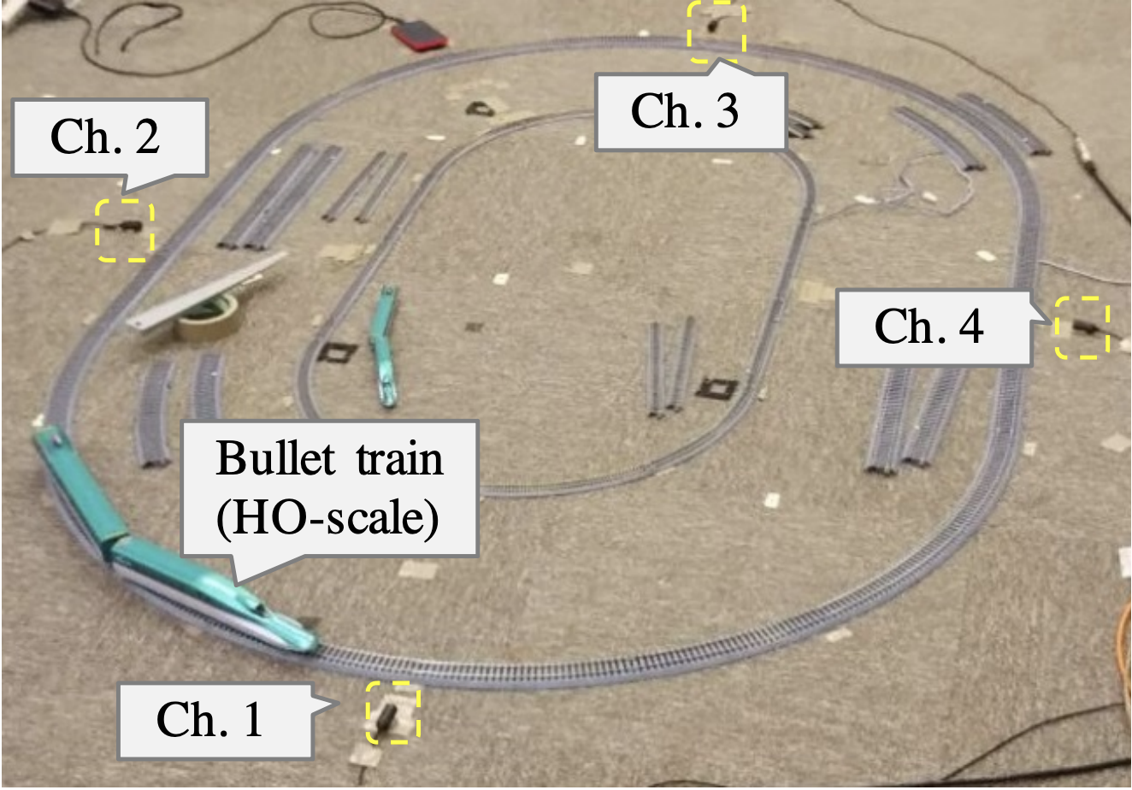
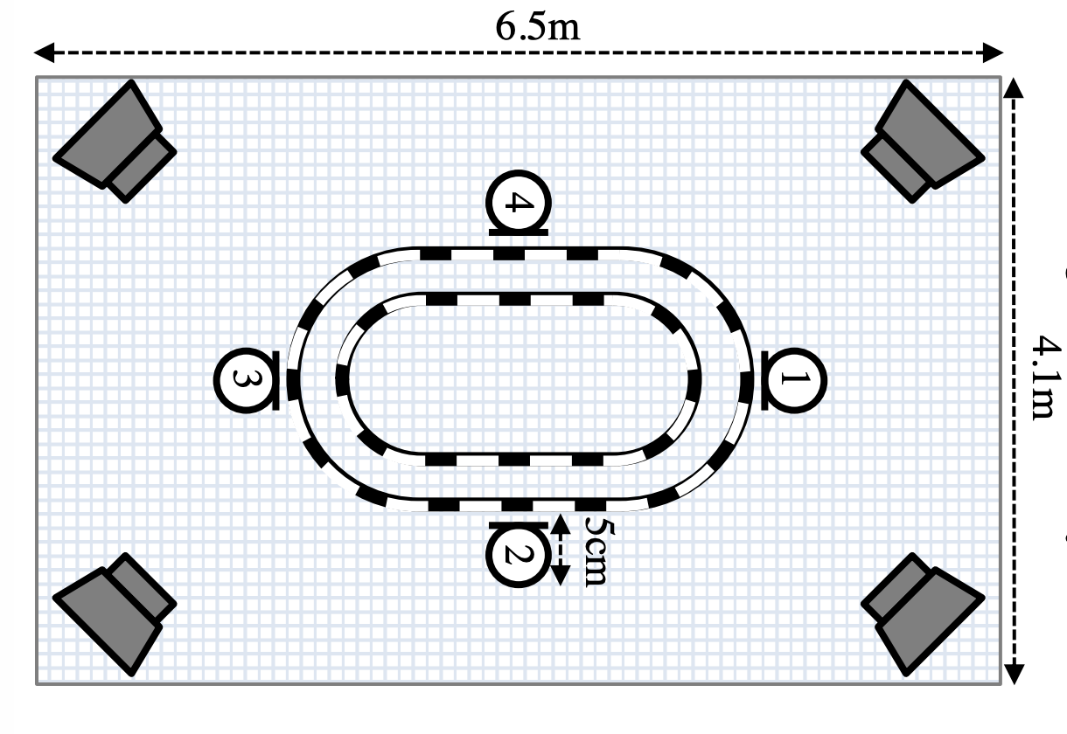
Example: ToyADMOS
540 hours of sound for anomaly detection
Based on toys:
Car
Conveyor
Train
Notes:
Meet ToyADMOS, A Dataset Of Miniature Machine Operating Sounds
ToyADMOS dataset is a machine operating sounds dataset of approximately 540 hours of normal machine operating sounds and over 12,000 samples of anomalous sounds collected with four microphones at a 48kHz sampling rate.
Here, each sub-dataset consists of three types of sound data, they are normal, anomalous, and environmental. For collecting the sounds, four omnidirectional microphones (SHURE SM11-CN) were used.
The ToyADMOS dataset has the following characteristics:
It is designed for three ADMOS tasks: product inspection (toy car), fault diagnosis for a fixed machine (toy conveyor), and fault diagnosis for a moving machine (toy train).
Machine-operating sounds and environmental noise are individually recorded for simulating various noise levels.
All sounds are recorded with four microphones for testing noise reduction and/or data-augmentation techniques such as mix-up
In each task, multiple machines of the same class are used where each machine belongs to the same class of toys but has a different detailed structure. Since the collected operating sounds have variations depending on individual differences, the dataset can be used for testing domain-adaptation techniques to absorb individual differences and/or changes in noise level.
Each anomalous sound was recorded several times for testing a few-shot learning-based ADMOS for obtaining the characteristics of anomalous sounds from only a few samples.
The released dataset consists of over 180 hours of normal machine-operating sounds and over 4,000 samples of anomalous sounds collected with four microphones at a 48-kHz sampling rate for each task.
https://arxiv.org/abs/1908.03299

Slide 14
Example: ToyADMOS
540 hours of sound for anomaly detection
Based on toys:
Car
Conveyor
Train
Anomalies captured by deliberately damaging the toys
Notes:
The ToyADMOS dataset has the following characteristics:
It is designed for three ADMOS tasks: product inspection (toy car), fault diagnosis for a fixed machine (toy conveyor), and fault diagnosis for a moving machine (toy train).
Machine-operating sounds and environmental noise are individually recorded for simulating various noise levels.
All sounds are recorded with four microphones for testing noise reduction and/or data-augmentation techniques such as mix-up
In each task, multiple machines of the same class are used where each machine belongs to the same class of toys but has a different detailed structure. Since the collected operating sounds have variations depending on individual differences, the dataset can be used for testing domain-adaptation techniques to absorb individual differences and/or changes in noise level.
Each anomalous sound was recorded several times for testing a few-shot learning-based ADMOS for obtaining the characteristics of anomalous sounds from only a few samples.
The released dataset consists of over 180 hours of normal machine-operating sounds and over 4,000 samples of anomalous sounds collected with four microphones at a 48-kHz sampling rate for each task.

Slide 15
ToyADMOS Dataset Characteristics
Designed for three ADMOS tasks:
Product inspection (toy car),
Fault diagnosis for a fixed machine (toy conveyor)
Fault diagnosis for a moving machine (toy train)

Slide 16
ToyADMOS Dataset Characteristics
Designed for three ADMOS tasks:
Product inspection (toy car),
Fault diagnosis for a fixed machine (toy conveyor)
Fault diagnosis for a moving machine (toy train)
Machine-operating sounds and environmental noise are individually recorded for simulating various noise levels

Slide 17
ToyADMOS Dataset Characteristics
Designed for three ADMOS tasks:
Product inspection (toy car),
Fault diagnosis for a fixed machine (toy conveyor)
Fault diagnosis for a moving machine (toy train)
Machine-operating sounds and environmental noise are individually recorded for simulating various noise levels
All sounds are recorded with four microphones
Testing noise reduction
Data-augmentation techniques such as mix-up

Slide 18
ToyADMOS Dataset Characteristics
Record multiple machines of same class
Different structure → Individual variations despite same toy class

Slide 19
ToyADMOS Dataset Characteristics
Record multiple machines of same class
Different structure → Individual variations despite same toy class
Record several times
Anomalous sound characteristics from few samples

Slide 20
ToyADMOS Dataset Characteristics
Record multiple machines of same class
Different structure → Individual variations despite same toy class
Record several times
Anomalous sound characteristics from few samples
180 hours of normal machine-operating sounds alongside over 4,000 samples of anomalous sounds
collected at a 48kHz sampling rate for each task

Slide 21
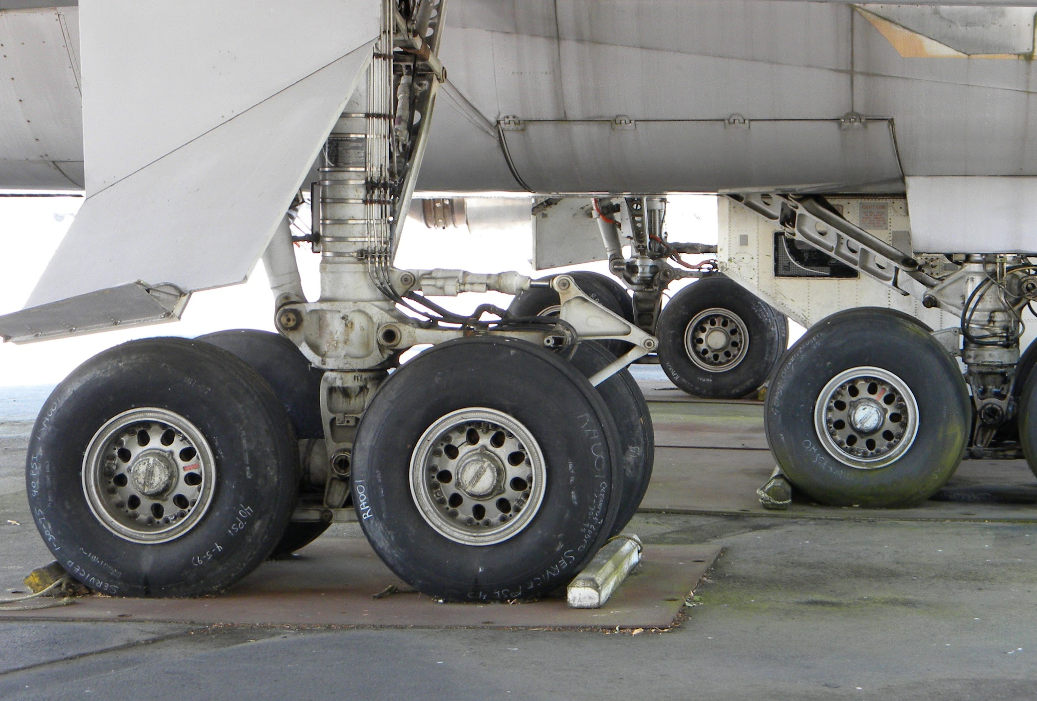
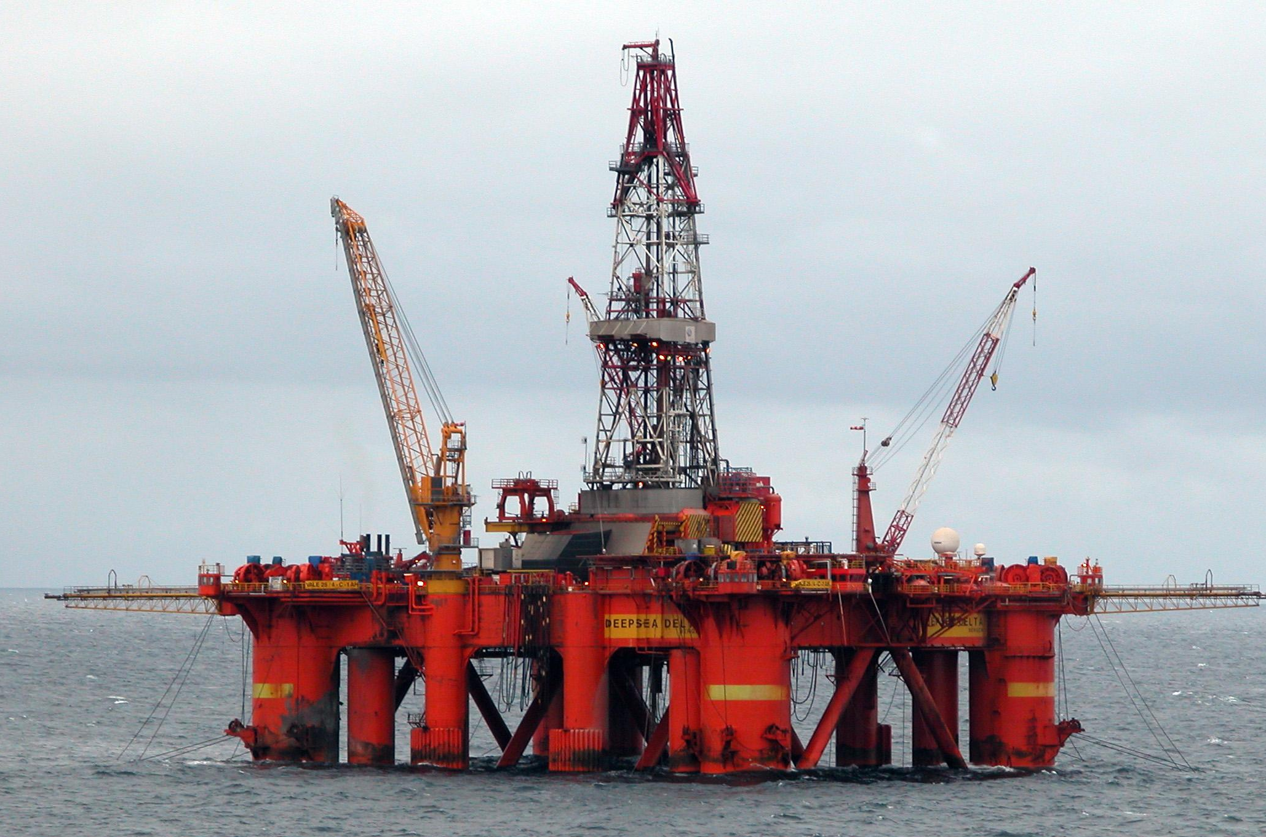
Low Transferability
An anomaly detection model will be very specific to the training set and therefore difficult to generalize to other deployment environments
Notes:
Anomaly detection models will essentially intentionally “overfit” to the training data
https://commons.wikimedia.org/wiki/File:Oil_platform_in_the_North_Sea.jpg
https://commons.wikimedia.org/wiki/File:Boeing_747_prototype_main_landing_gear.jpg

Slide 22
What are we going to learn?
Collect and Preprocess Data
Design
and Train
Model
Evaluate, Optimize, Convert, Deploy
Make
Inferences
Micro
Challenges with an Anomaly Detection Application
Anomaly Detection ML Pipeline
Training, Testing
in Colab
Notes:
Challenges = Bandwidth, Battery, Latency, Accuracy, Datasets
The AD ML Pipeline = Real World case studies of how to anomaly detection implemented in industry
Hands-on training and of anomaly detection models in Colab!

Slide 23
Notes:
There are many more applications of tinyML in industry. Next you will read about a few other unique real world examples

Slide 24
Unsupervised learning
Supervised Learning
Notes:
Solution: employ unsupervised learning. Which trains a model to look for previously undetected patterns in a data set with no pre-existing labels

Slide 25
Unsupervised learning
Supervised Learning
Notes:
Solution: employ unsupervised learning. Which trains a model to look for previously undetected patterns in a data set with no pre-existing labels

Slide 26
Unsupervised learning
Supervised Learning
Unsupervised Learning
Notes:
Solution: employ unsupervised learning. Which trains a model to look for previously undetected patterns in a data set with no pre-existing labels

Slide 27
Unsupervised learning
Supervised Learning
Unsupervised Learning
Notes:
Solution: employ unsupervised learning. Which trains a model to look for previously undetected patterns in a data set with no pre-existing labels

